Slide 1

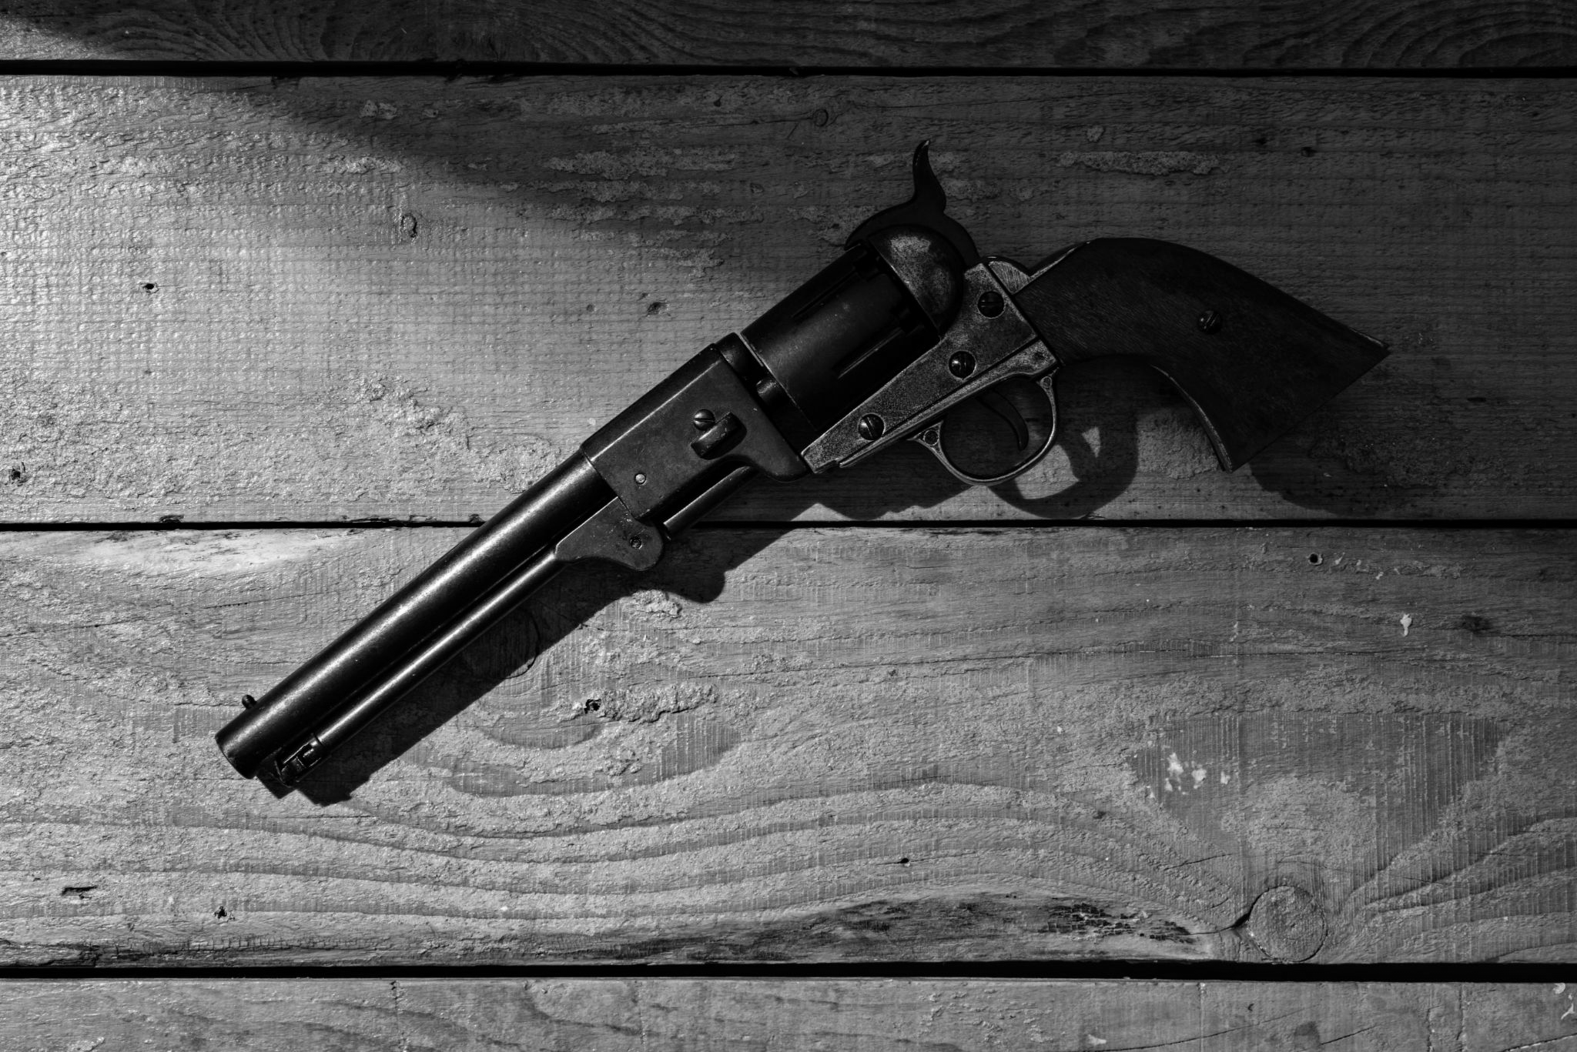

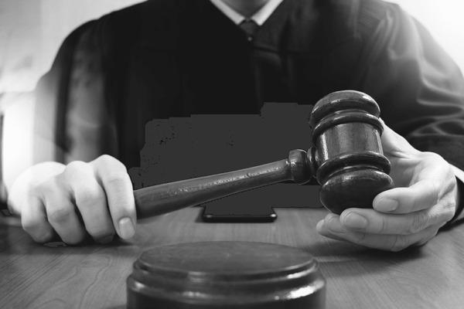
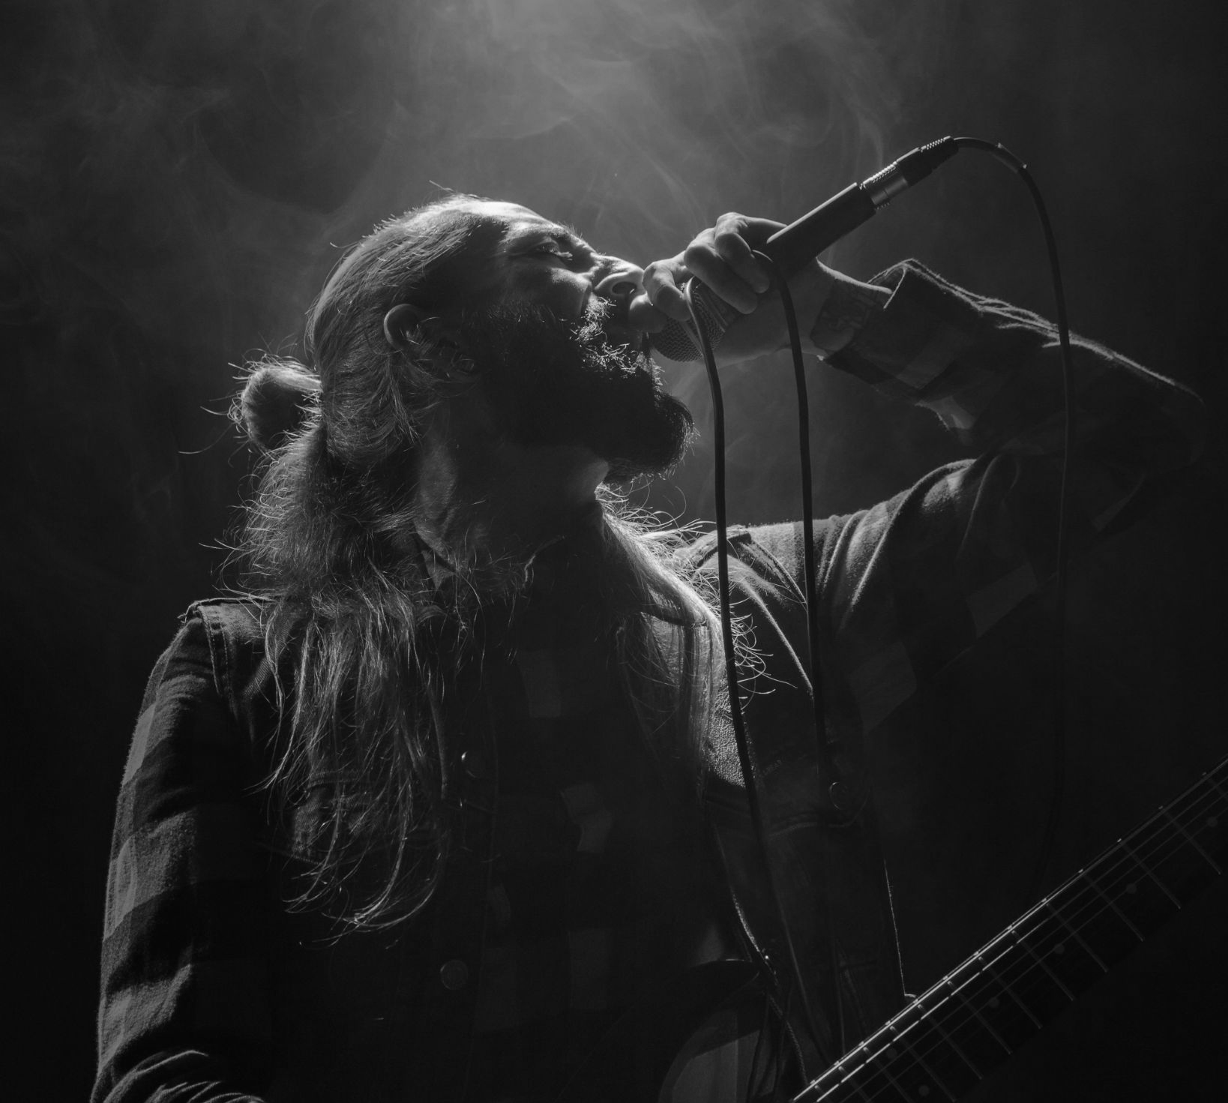
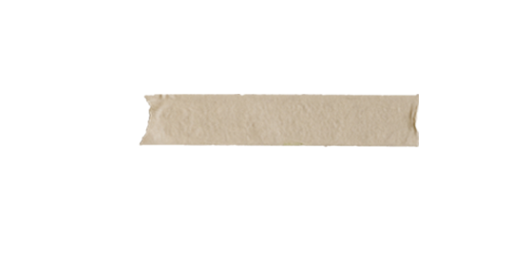
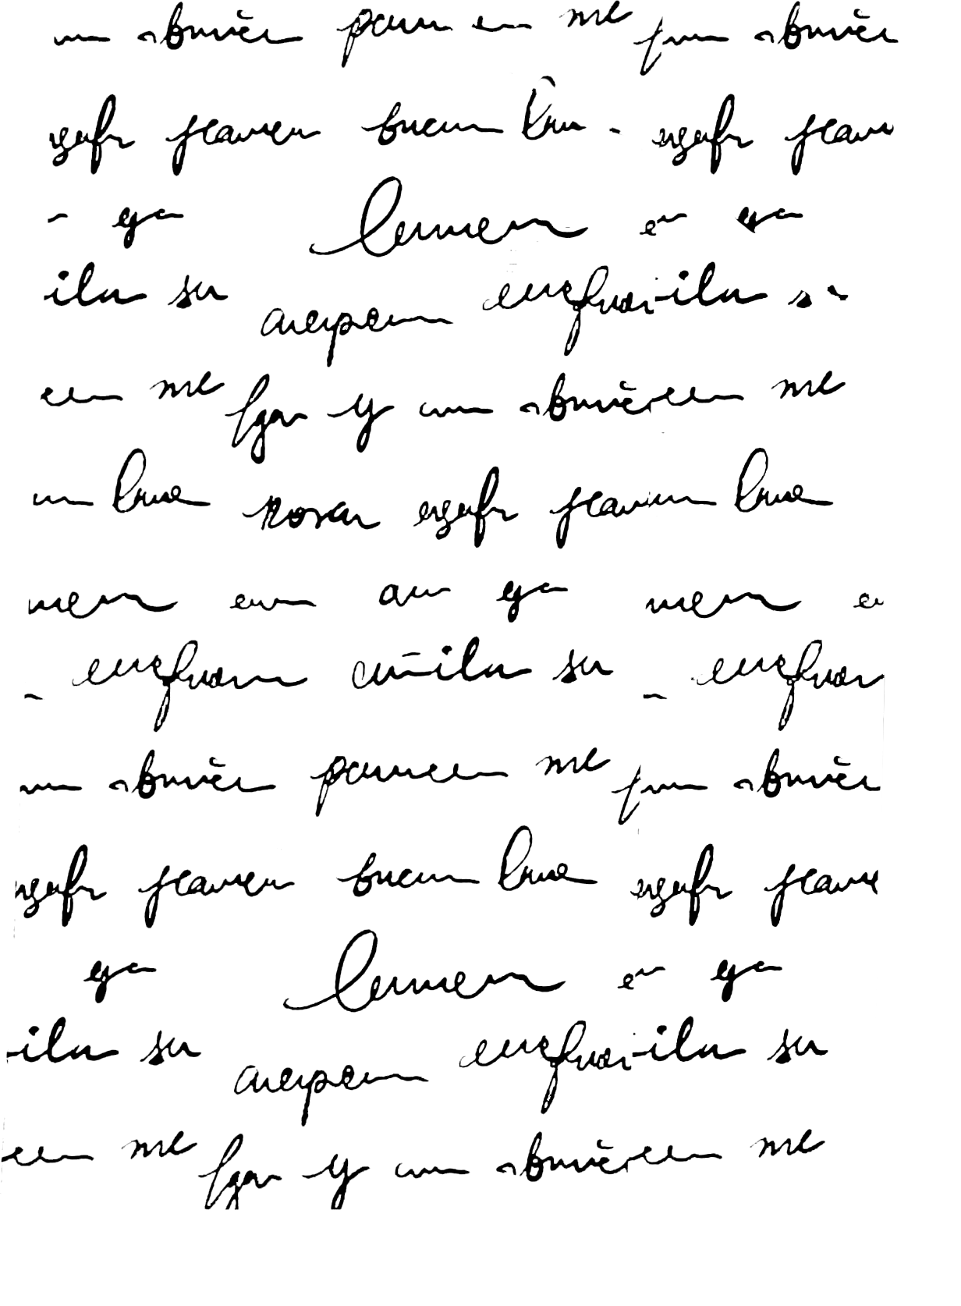
Final Thoughts:
Sentiment Analysis
On Last Statements
Jeffrey Pinarchick, Nikhil Poluri, Tyler McCormick, Younghoon Kim, Sam Gold

Slide 2
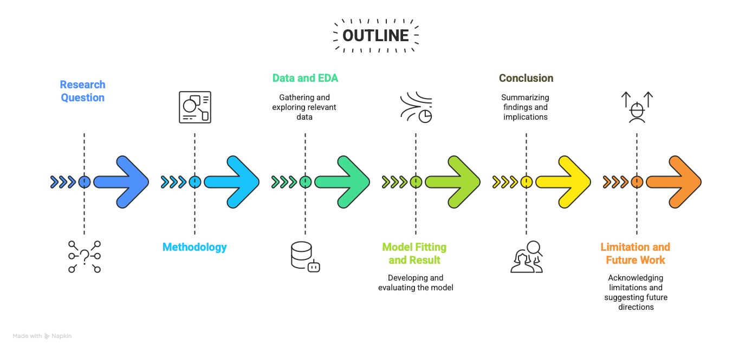

Slide 3

How Do Humans comprehend Death?
What do people say in their last words
If you knew that you were going to die, what would you say?
What is your last word? Who would you think of?
Notes:
“What can we learn from a modern collection of last words? Those sentenced to die have three pieces of information the rest of us don’t: the time and manner of their death and the knowledge that their last words will be recorded.”
“Last words matter for one simple reason: they cannot be taken back. We expect last words to be poignant, a résumé or summation of life experience. Sometimes they are, sometimes they are not. We want them to reveal secrets. But they very seldom do”

Slide 4
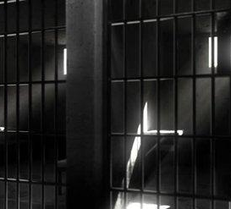
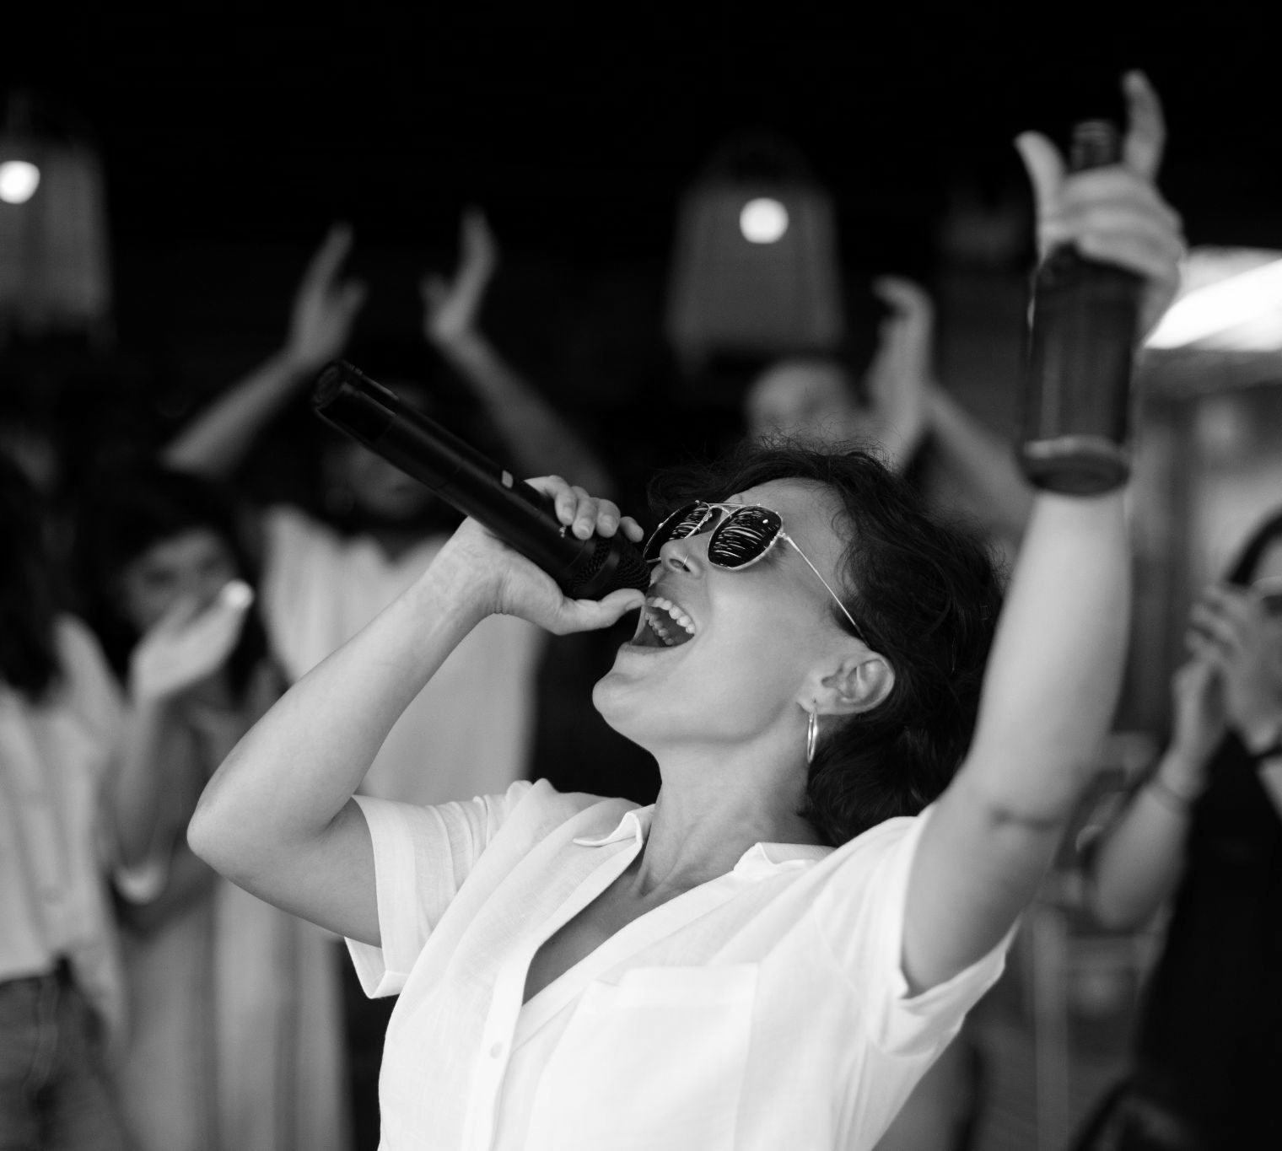
—JAMES FILIAGGI, 2007
“When the Browns are in the Super Bowl in the next five years, you'll know I'm up there doing my magic…”

Slide 5
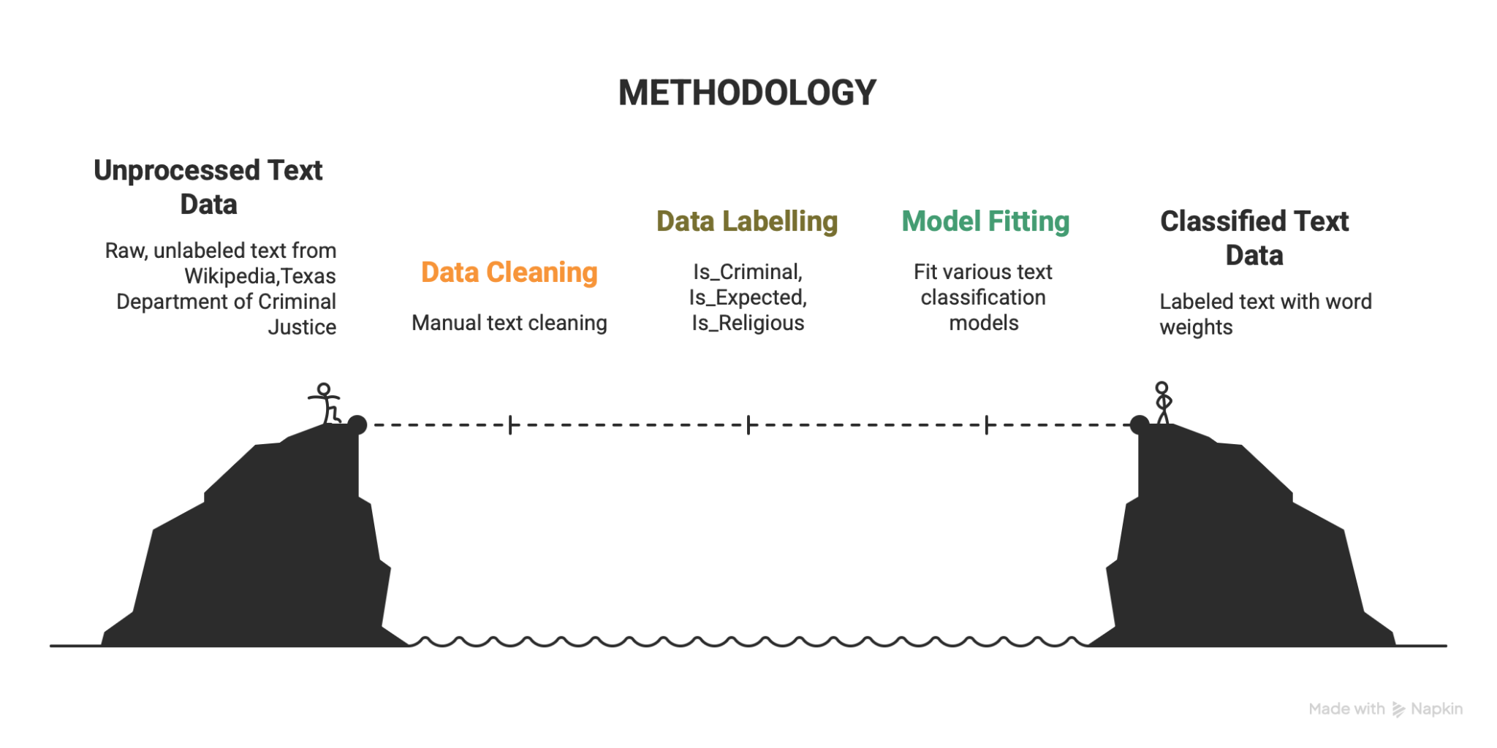

Slide 6
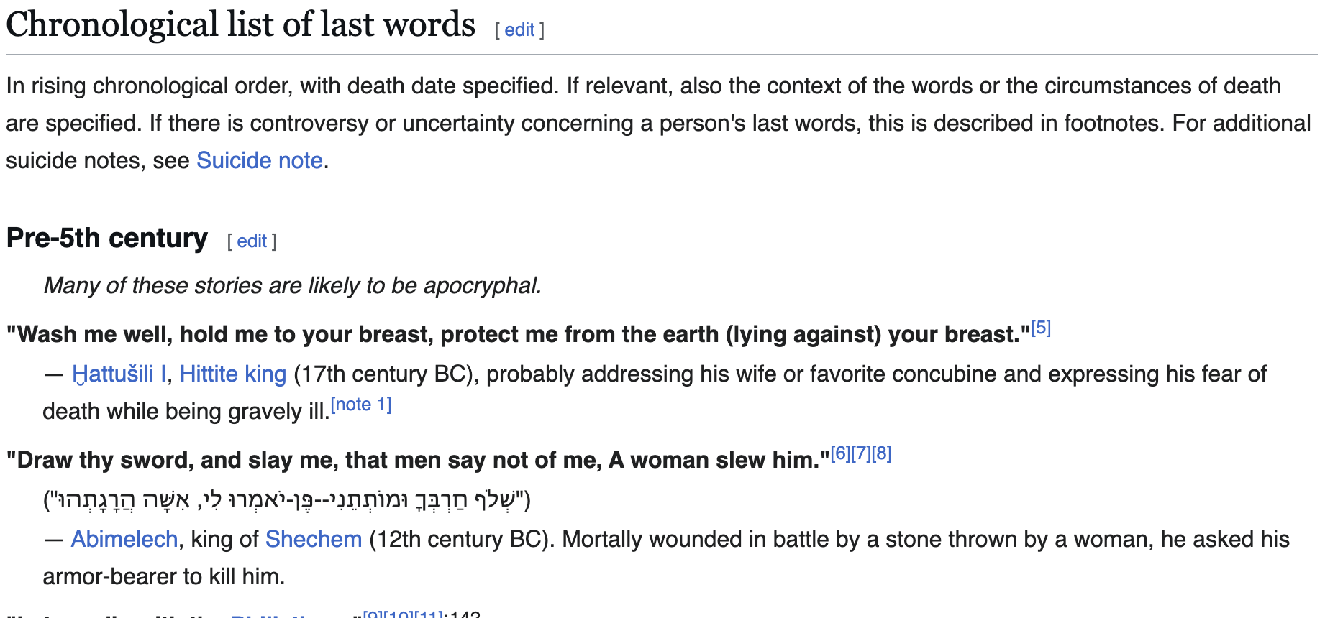
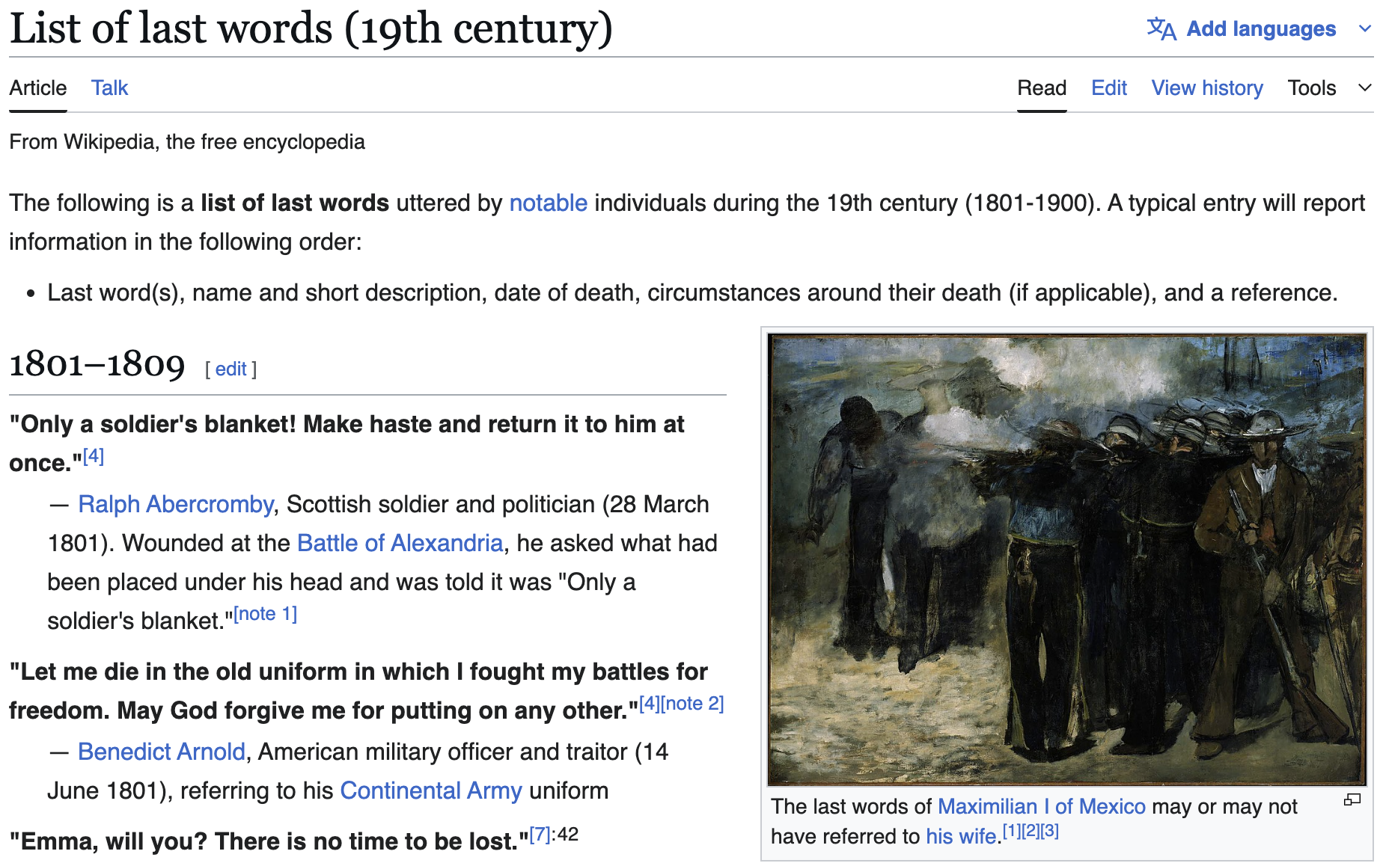
Wiki Data
5 Wikipedia Articles of Last Words:
Pre-5th to 17th Century
Ironic/Notable
18th Century
19th Century
20th Century
21st Century
Roughly 2000 entries
Gathered via the Wikipedia API

Slide 7
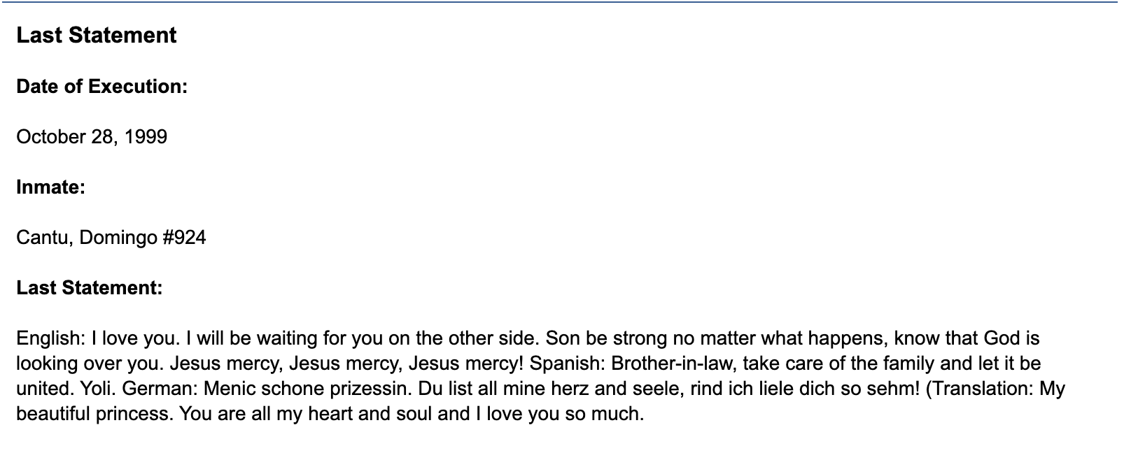
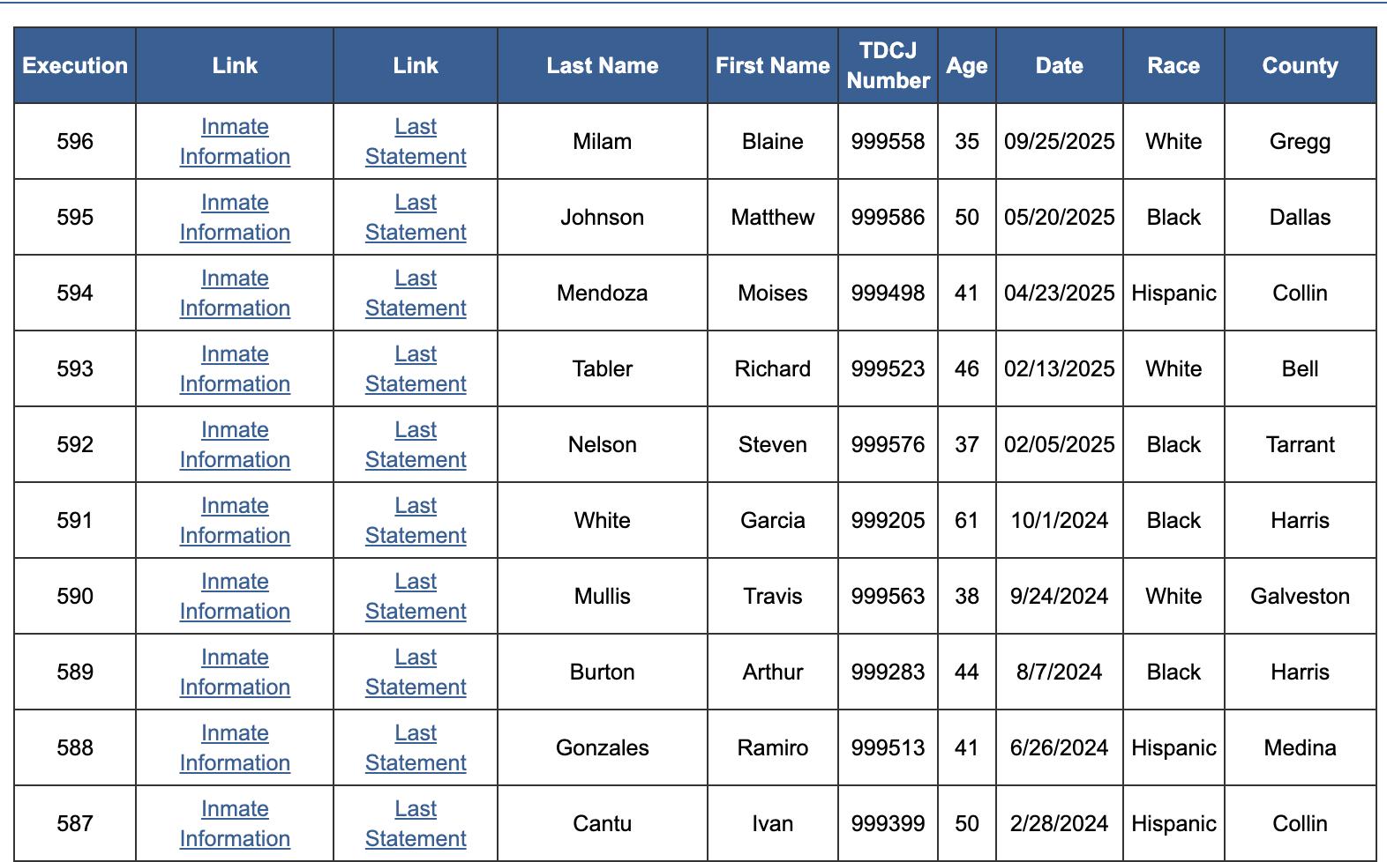
TEXAS Death Row Data
596 Entries
Years: 1982 - 2025
Scraped from 2 sources:
Executed Prisoners
Last Statement
Included English Translations of Statements

Slide 8
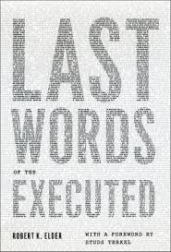
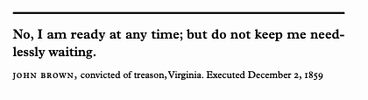
Last Words Of The Executed Data
Recorded Statements of Executed Criminals from the 1600s to 2000s
355 entries
Divided into five chapters according to modern execution methods

Slide 9
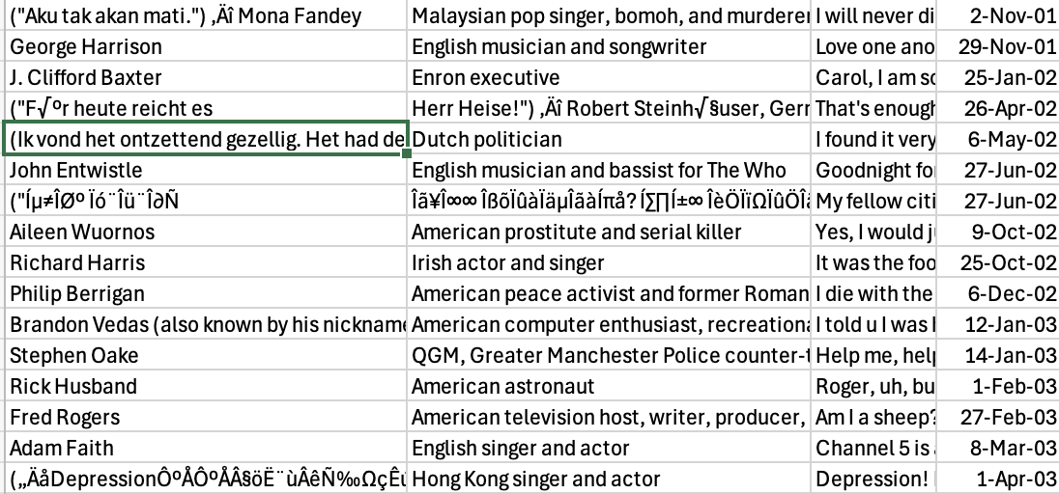
Cleaning Text is very TRICKY!
Converting Wiki API to .csv files had formatting errors
Translations where names should be, weird characters in place, etc.
Adding indicator variables for our models
Criminal?
Aware?
Religious?

Slide 10
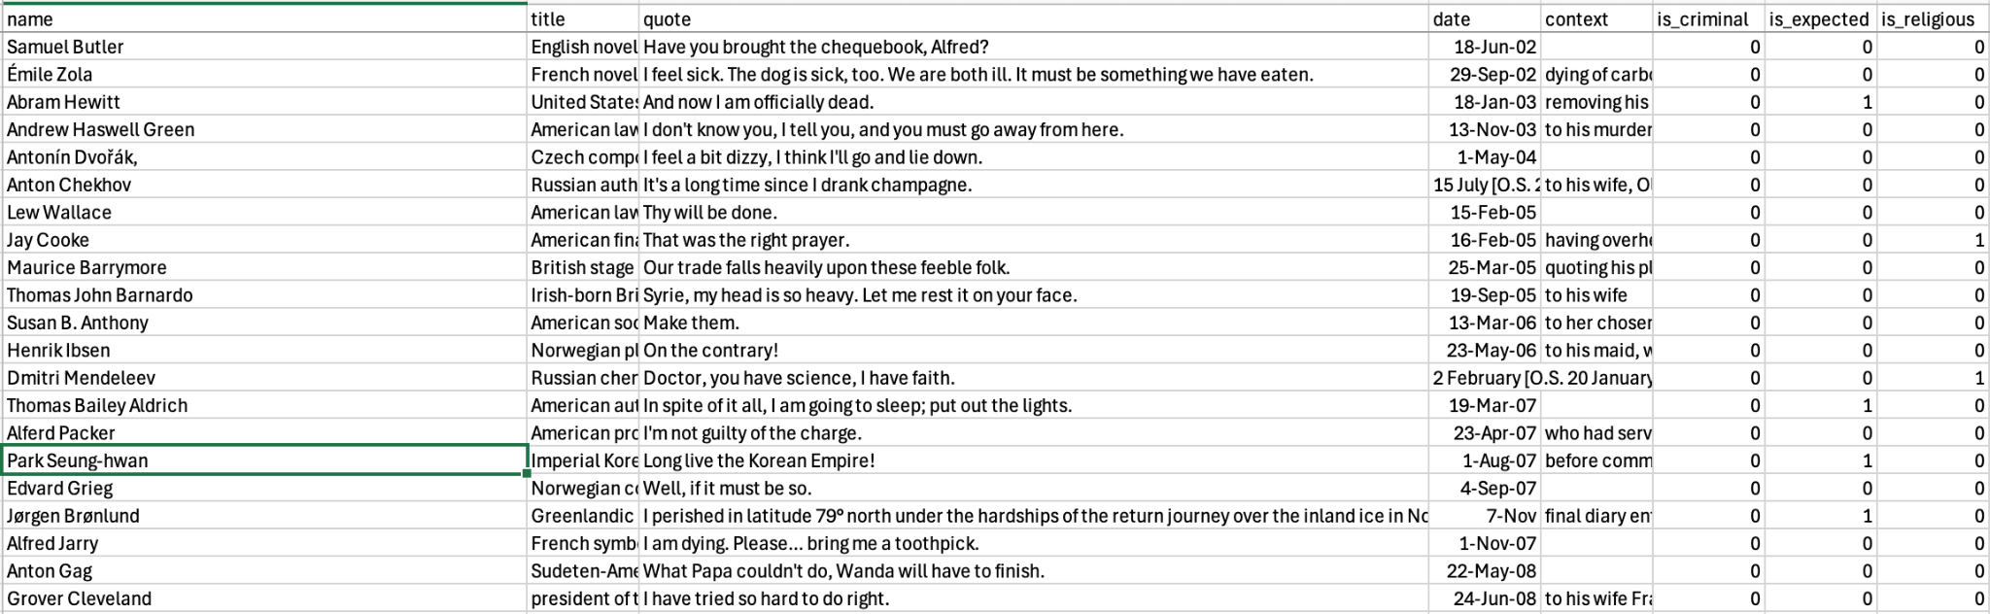
Our Final form of DATA

Slide 11
EDA of TEXT DATA

Slide 12
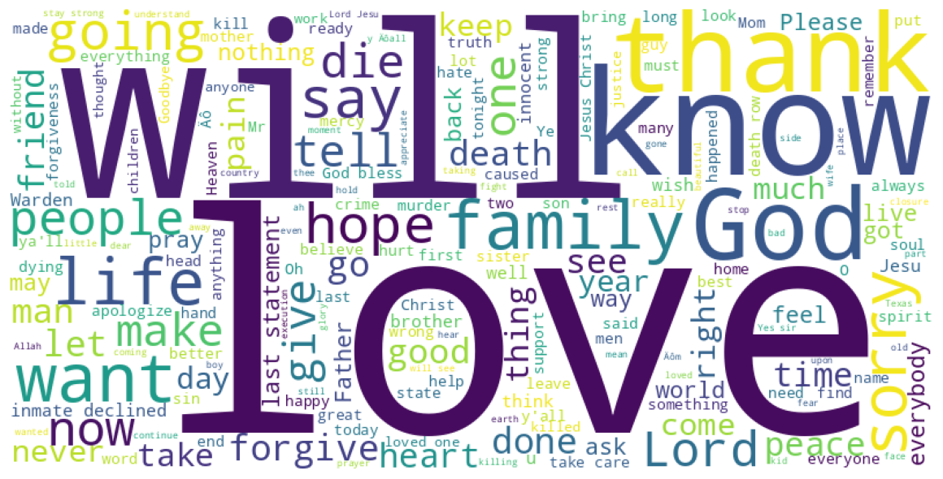
Top Words

Slide 13
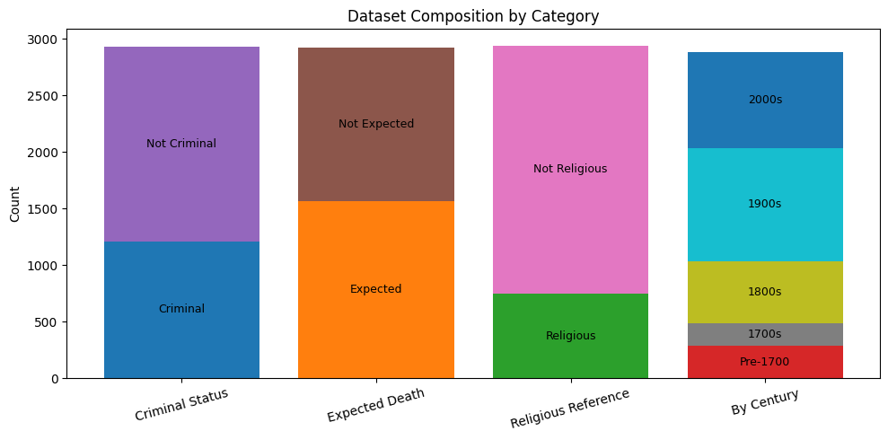
Subset Breakdown

Slide 14
Mapping Emotions

Slide 15
Modeling and Mapping Emotions
Roberta-base-go_emotions
Pretrained emotion text classifier model from Hugging Face
Fine-tuned on the GoEmotions dataset
28 different Emotion Labels
Outputs a probability for each emotion based on the input text
Implementation
The model was used to in two different analyses pipelines
Identifying the top emotion within each final statement
Identifying the presence of remorse within each statement

Slide 16
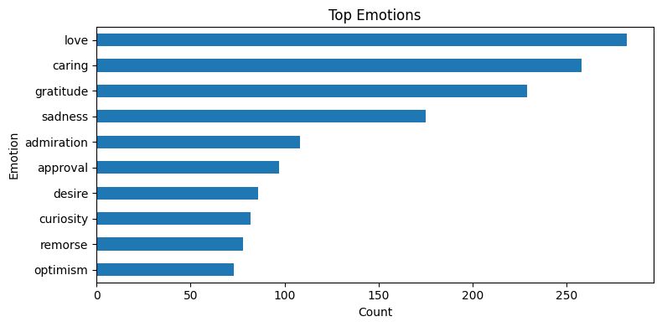
Love Triumphed

Slide 17
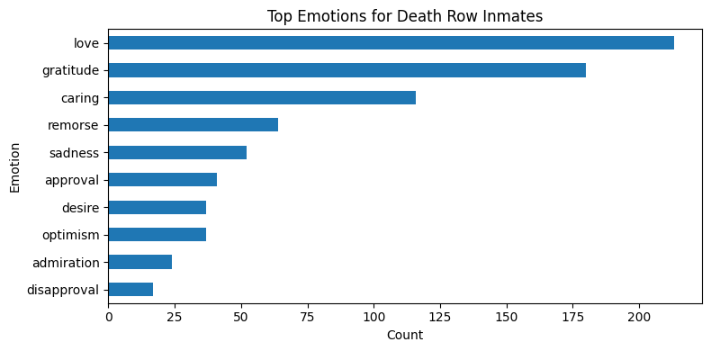
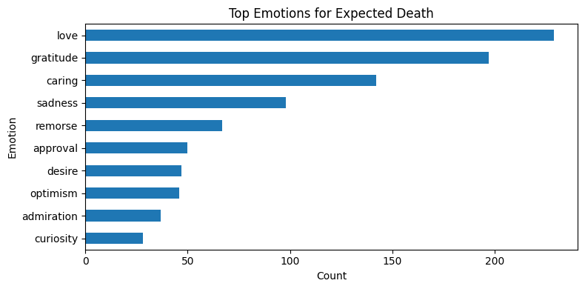
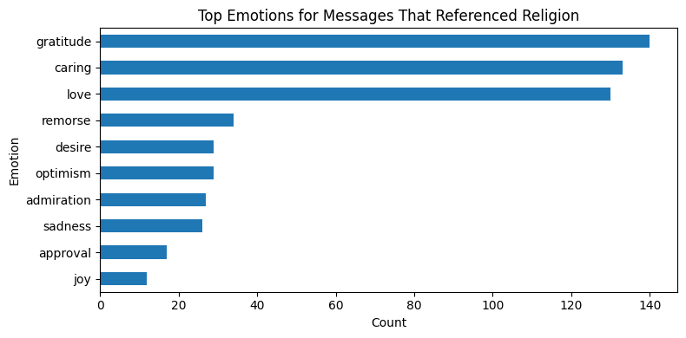
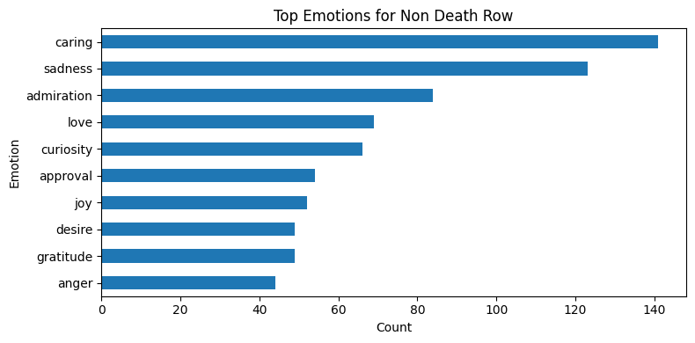
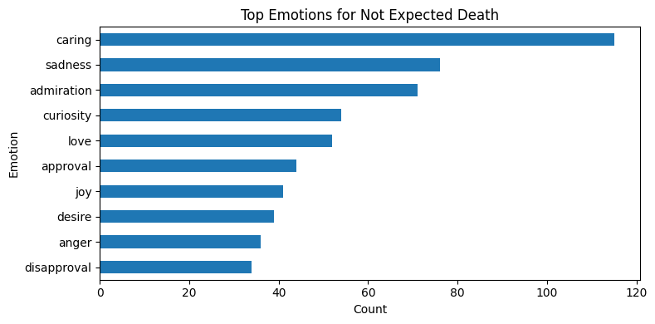
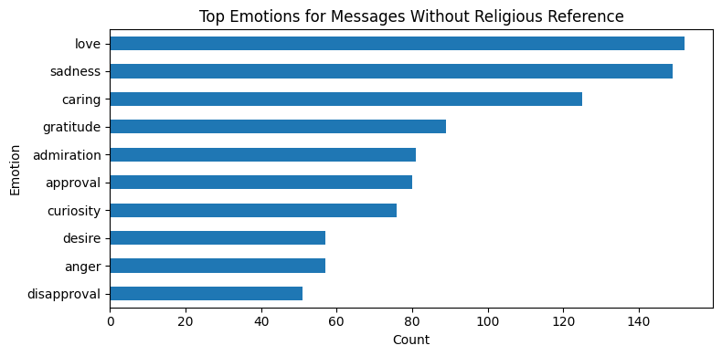
Religion and Expected softens emotional tone by replacing anger and sadness with gratitude and care.
Death-row inmates show higher rates of love, gratitude, and remorse than non-criminal deaths.

Slide 18
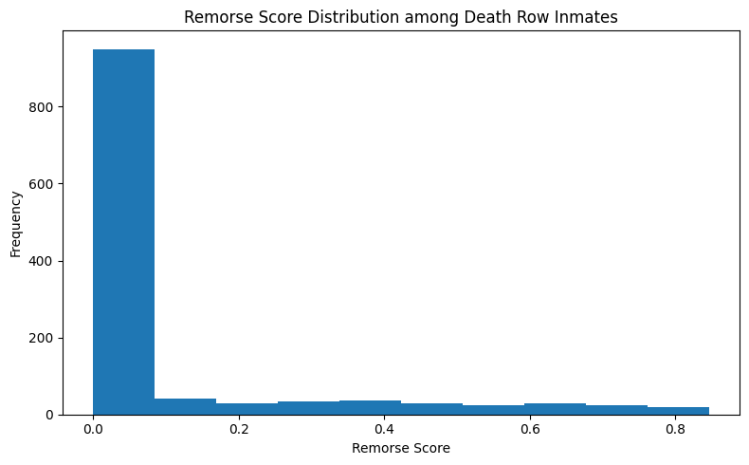
Remorse Among Death Row Inmates was Less than Expected

Slide 19
Topic/Theme Modelling

Slide 20
Last Statements Consistently Express Four Universal Themes
Method
○ Used LDA Topic Modeling to uncover hidden themes in 3,000+ last statements ○ Tested K = 4, 6, 8 topics — K = 4 achieved the highest coherence (best model fit) ○ Each document is represented as a blend of multiple topics (a probability distribution across themes)
Discovered Themes (K = 4)
Topic | Short Label | Top Words (examples)
0 | Affection / Apology | love, family, thank, know, want, sorry, statement, tell, say, would_like
1 | Mortality / Death | die, death, go, life, prior, god, prior_execution, man, kill
2 | Religious / Repentance | love, god, lord, forgive, thank, know, family, ask, sorry, pray
3 | Reflection | go, get, say, know, kill, people, would, die, want, life

Slide 21
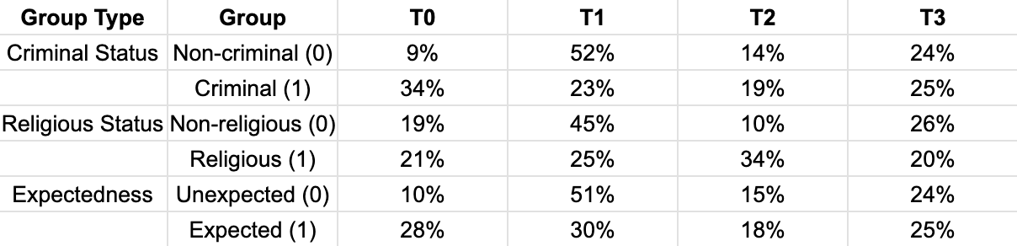
Key Group Differences
Criminal vs Non-Criminal
○ Criminal statements place more weight on the Affection / Remorse theme (Criminal = 0.34, Non-criminal = 0.09) ○ Non-criminal statements place more weight on the Mortality / Death theme (Criminal = 0.23, Non-criminal = 0.52)
Religious vs Non-Religious
○ Religious individuals place substantially more weight on the Religious / Forgiveness theme (Religious = 0.34, Non-religious = 0.10) ○ Non-religious individuals place more weight on the Mortality / Death theme (Religious = 0.25, Non-religious = 0.45)
Expected vs Unexpected Death
○ Expected-death statements place more weight on Affection / Remorse (Expected = 0.28, Unexpected = 0.10) ○ Unexpected-death statements place more weight on Mortality / Death (Expected = 0.30, Unexpected = 0.51) ○ Reflection remains similar between groups (Expected ≈ 0.25, Unexpected ≈ 0.24)

Slide 22
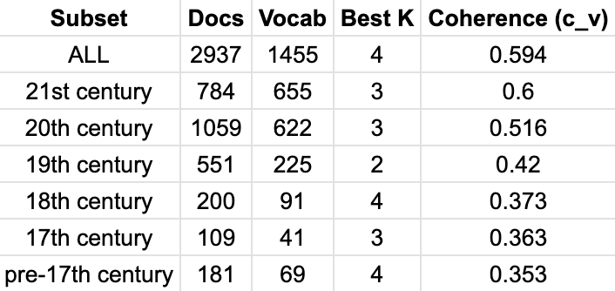
Thematic differences across centuries
Methods
Ran LDA topic modeling with a K-grid and picked K by highest coherence for each subset

Slide 23
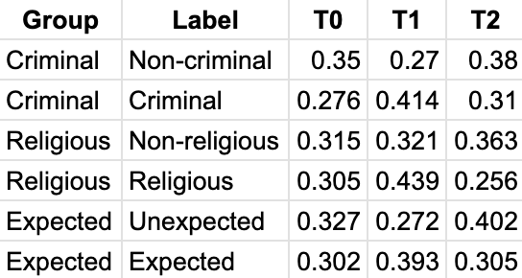
Thematic separation (19th - 21st Century)
20th Century (K = 3)
T1 (Criminality, Religion)
T2 (Expectedness of Death)
19th Century (K = 2)
T1 (Religious: 0.61, Non-Religious: 0.56)

Slide 24
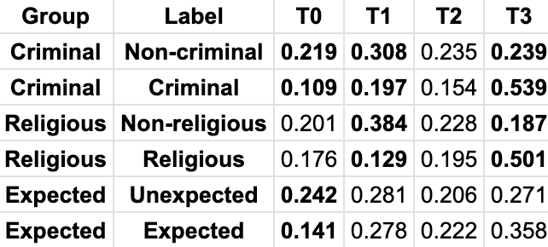
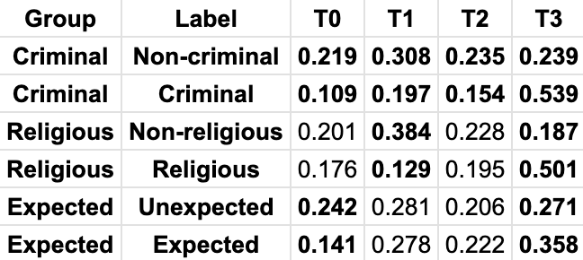
Thematic separation (Pre 17th - 18th Century)
18th Century (K = 4) - Left
Pre 17th Century (K = 4) - Right

Slide 25
Identifying Criminal Labels

Slide 26
Criminal labels can be identified through modeling
Model Goal
Predict whether someone was a criminal using their last statements before death
Two-stage pipeline approach
Determining words leading to high weights for each label
TF-IDF vectorization → Logistic Regression
Manual Labeling Bias
All labels assigned through manual annotation
The definition of a “criminal” in context of this model
Governing entity defining somebody as a criminal
Execution, hanging, war crimes
Changes in language/semantics over time

Slide 27
TF-IDF weighs words by importance
Term Frequency (TF)
Inverse Doc Frequency (IDF)
TF: Word’s term frequency in a quote
Local importance measure
Normalizes quote length to prevent skewed data
IDF: Measures word rarity across all quotes
Global importance measure
Up-weights signal words and down-weights common words
“I am sorry, I hope
you forgive me”
[“I”, “am”, “sorry”, “hope”, “you”, “forgive, “me”]
[.01, .02, .35, .22, .02, .54, .05]
Final Output: Numerical representation of a word’s importance to a quote given the entire collection of quotes

Slide 28
Binary classification predicts the criminal label
Logistic Regression
Quote | Criminal Label
“father forgive them for they know not…” | 1
“i feel sleepy and a moment of rest would…” | 0
TF-IDF vector representations as input
Assigns weights to each word
Positive coefficient → Criminal Label (1)
Negative coefficient → Non-Criminal Label (0)
Probability determined by weighted equation of
Attached to each word in the quote
P(Criminal) | P(Non-Criminal)
.0043 | .9957
.7412 | .2588
Final Output: Predictions (p) for the binary criminal label
Works well with TF-IDF features
Linear relationship fails to capture complex sentence structure, ignores unseen data

Slide 29
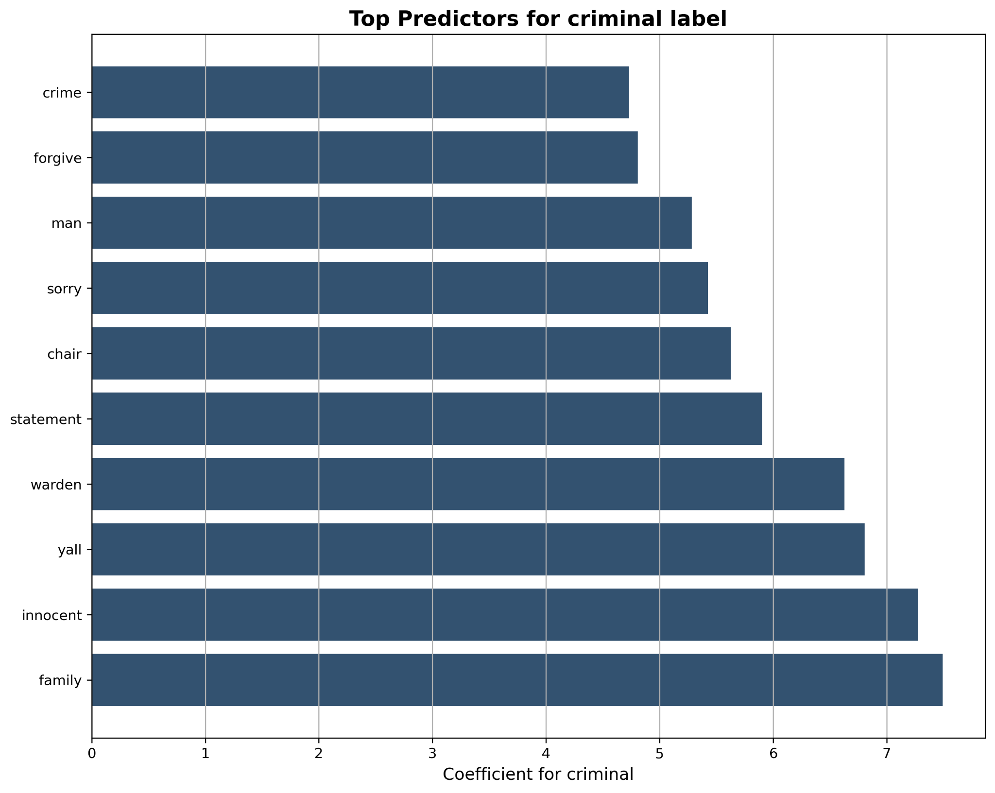
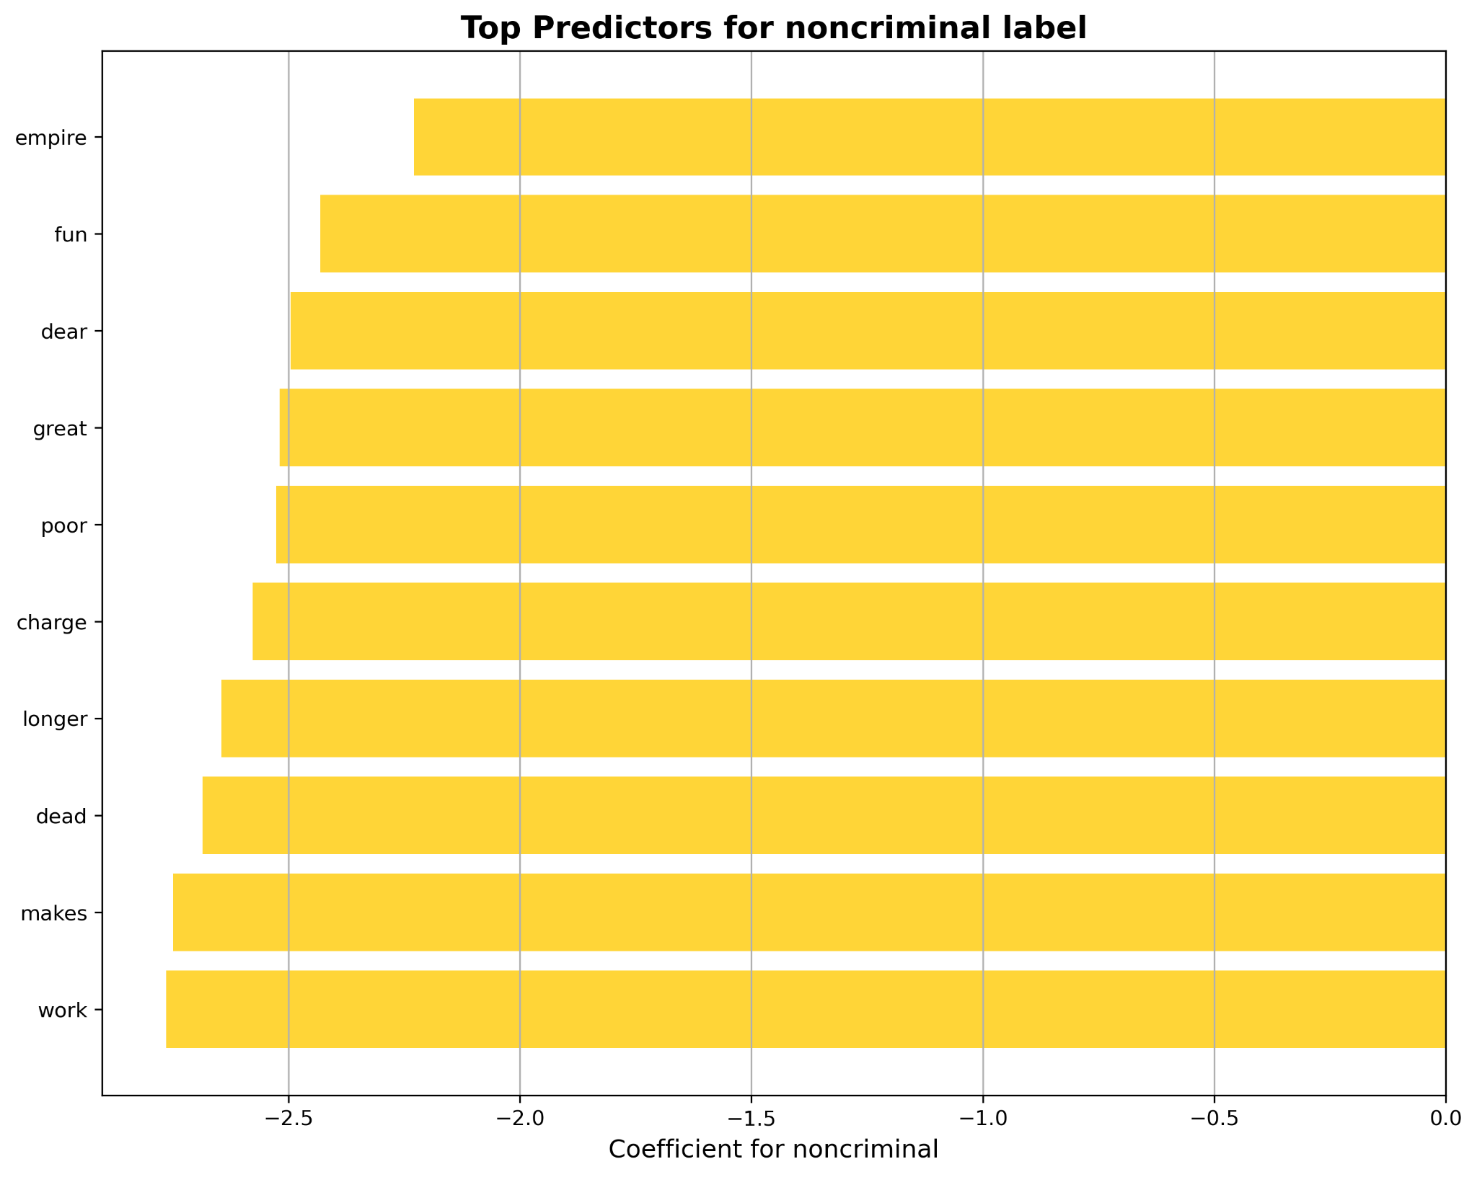
Predictor words for criminals tell a better story

Slide 30
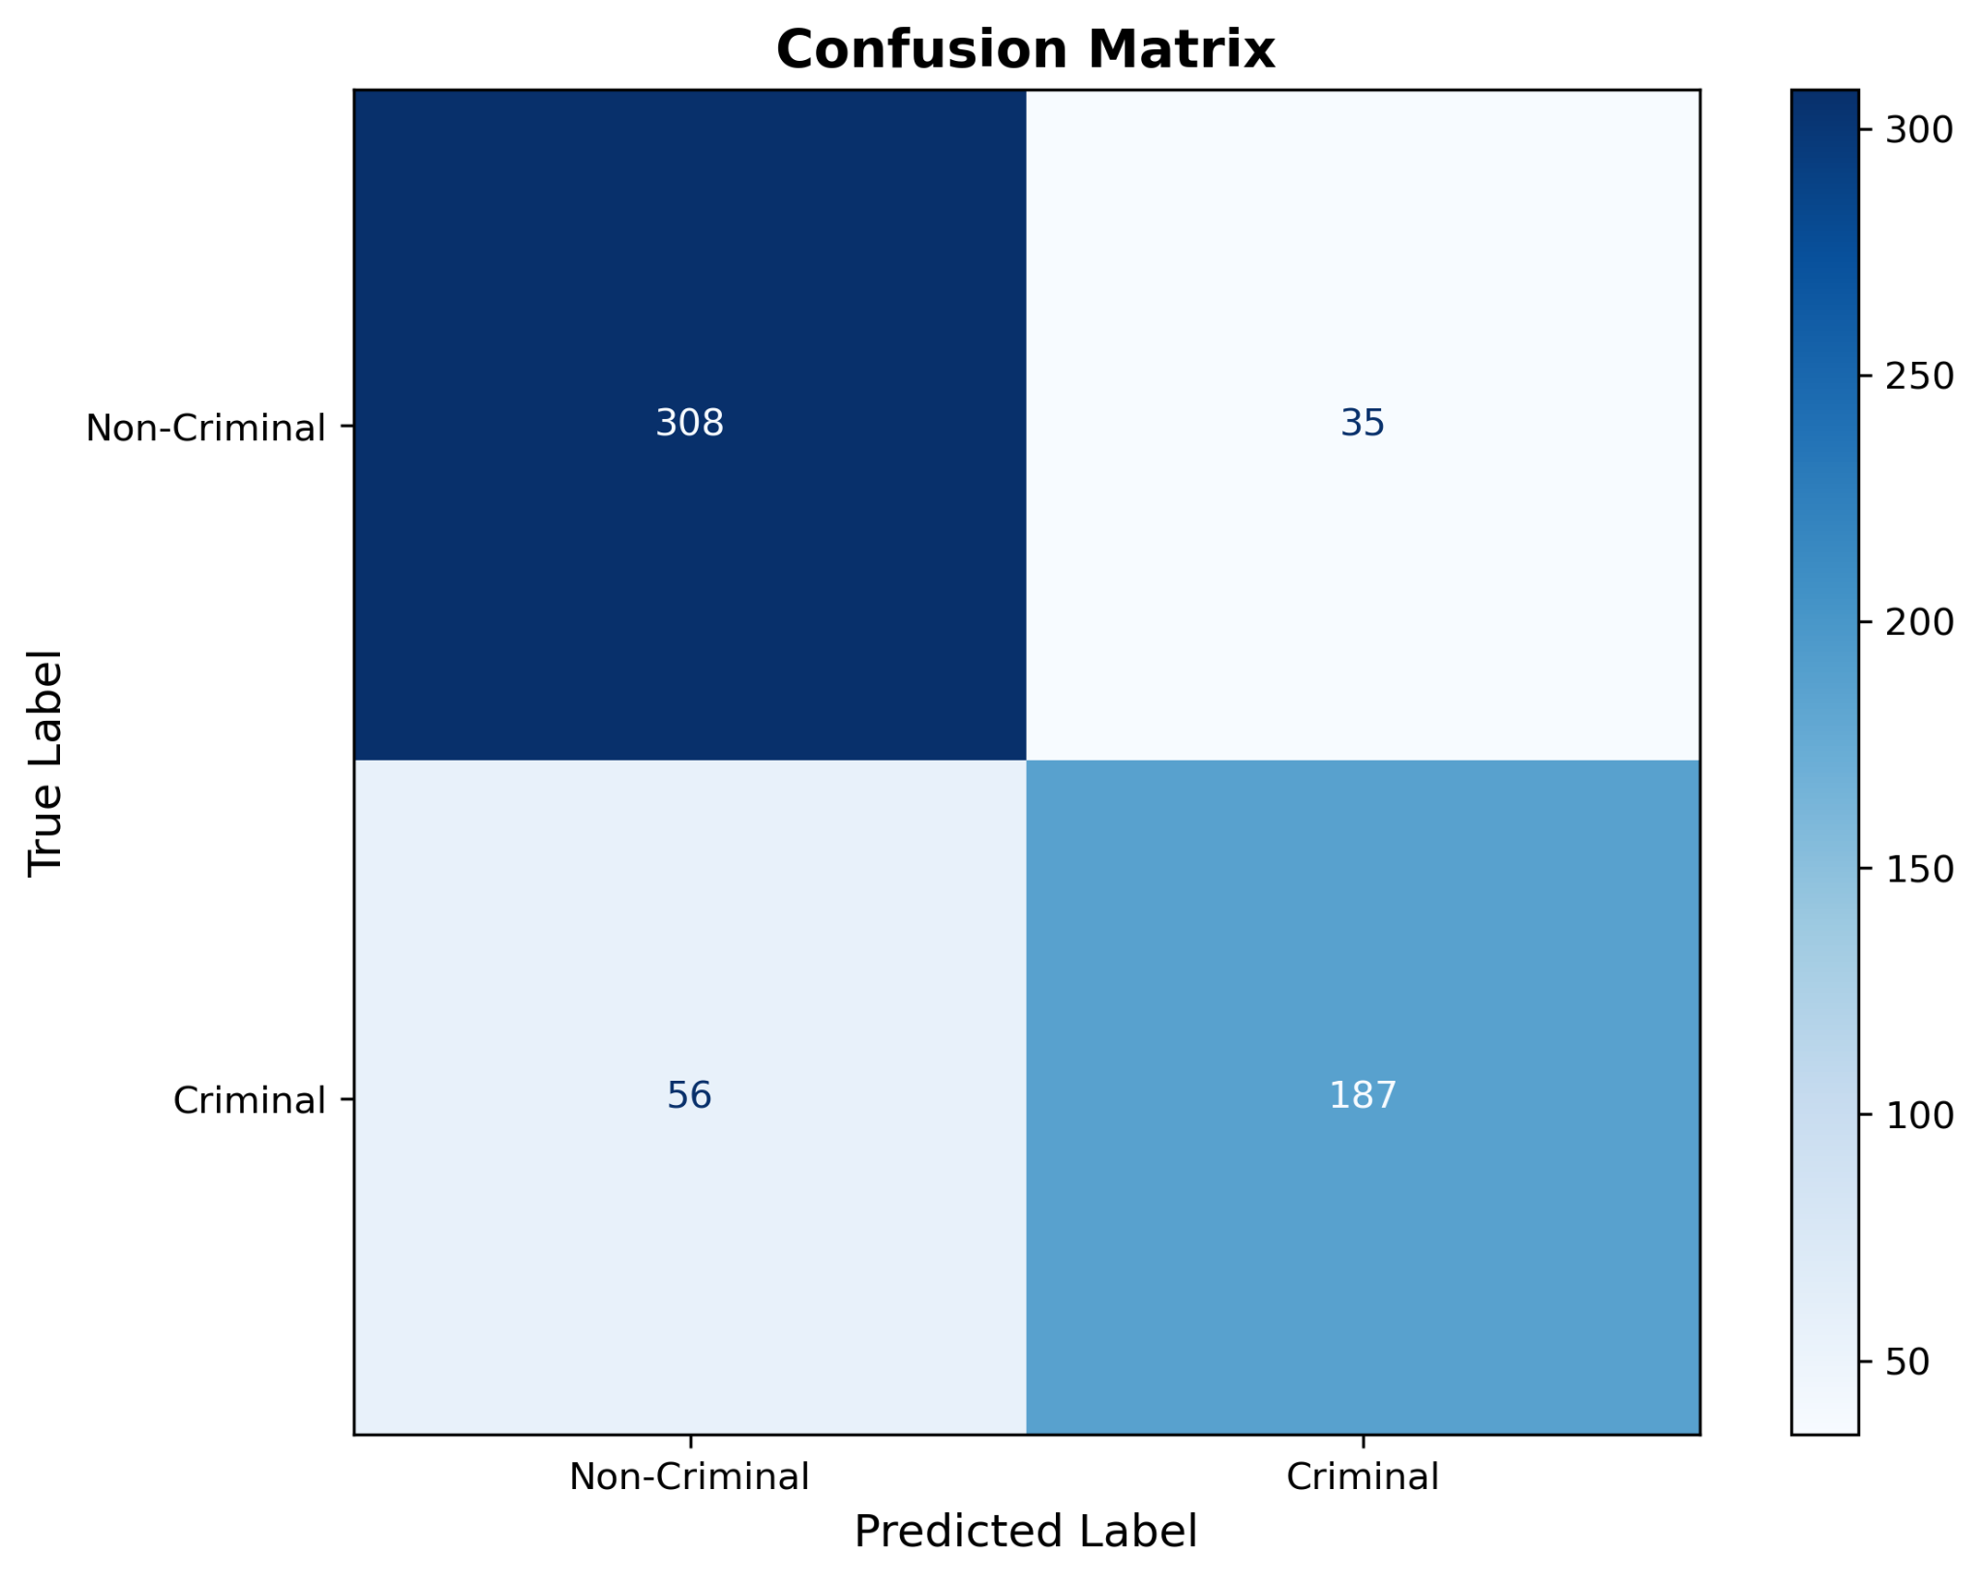
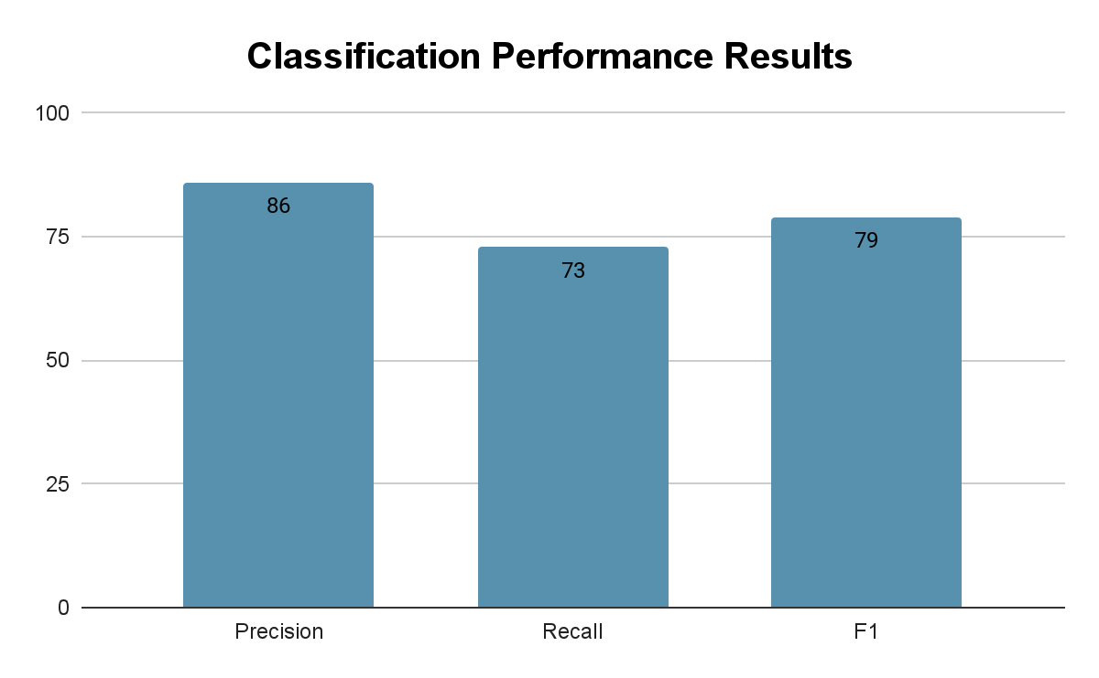
Stronger at identifying non-criminal quotes
Tuning the 𝜶 regularization parameter relates to the precision-recall tradeoff
High 𝜶 → Strict, fewer criminal labels, higher precision
Low 𝜶 → Lenient, more criminal labels, higher higher recall

Slide 31
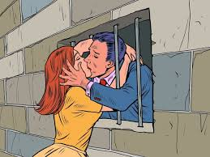
Conclusion
Top Emotions: Love, Caring, Gratitude
Criminals had higher rates of love, gratitude, and remorse than non-criminal deaths.
Although Remorse was lower than Expected
Religion and Expected replaced anger and sadness with gratitude and care.
Real-life context matters
Notes:
Add model overall conclusions
Average person spends around 20 years on Death Row before being executed

Slide 32


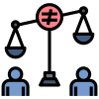
Limited Scope of Findings
The data was drawn from an overly selective subset.
Too Subjective Labelling.
Not representing the population
Need consistent standards
Statement are often recorded by third parties.
The meaning of the Statement could be altered.

Slide 33
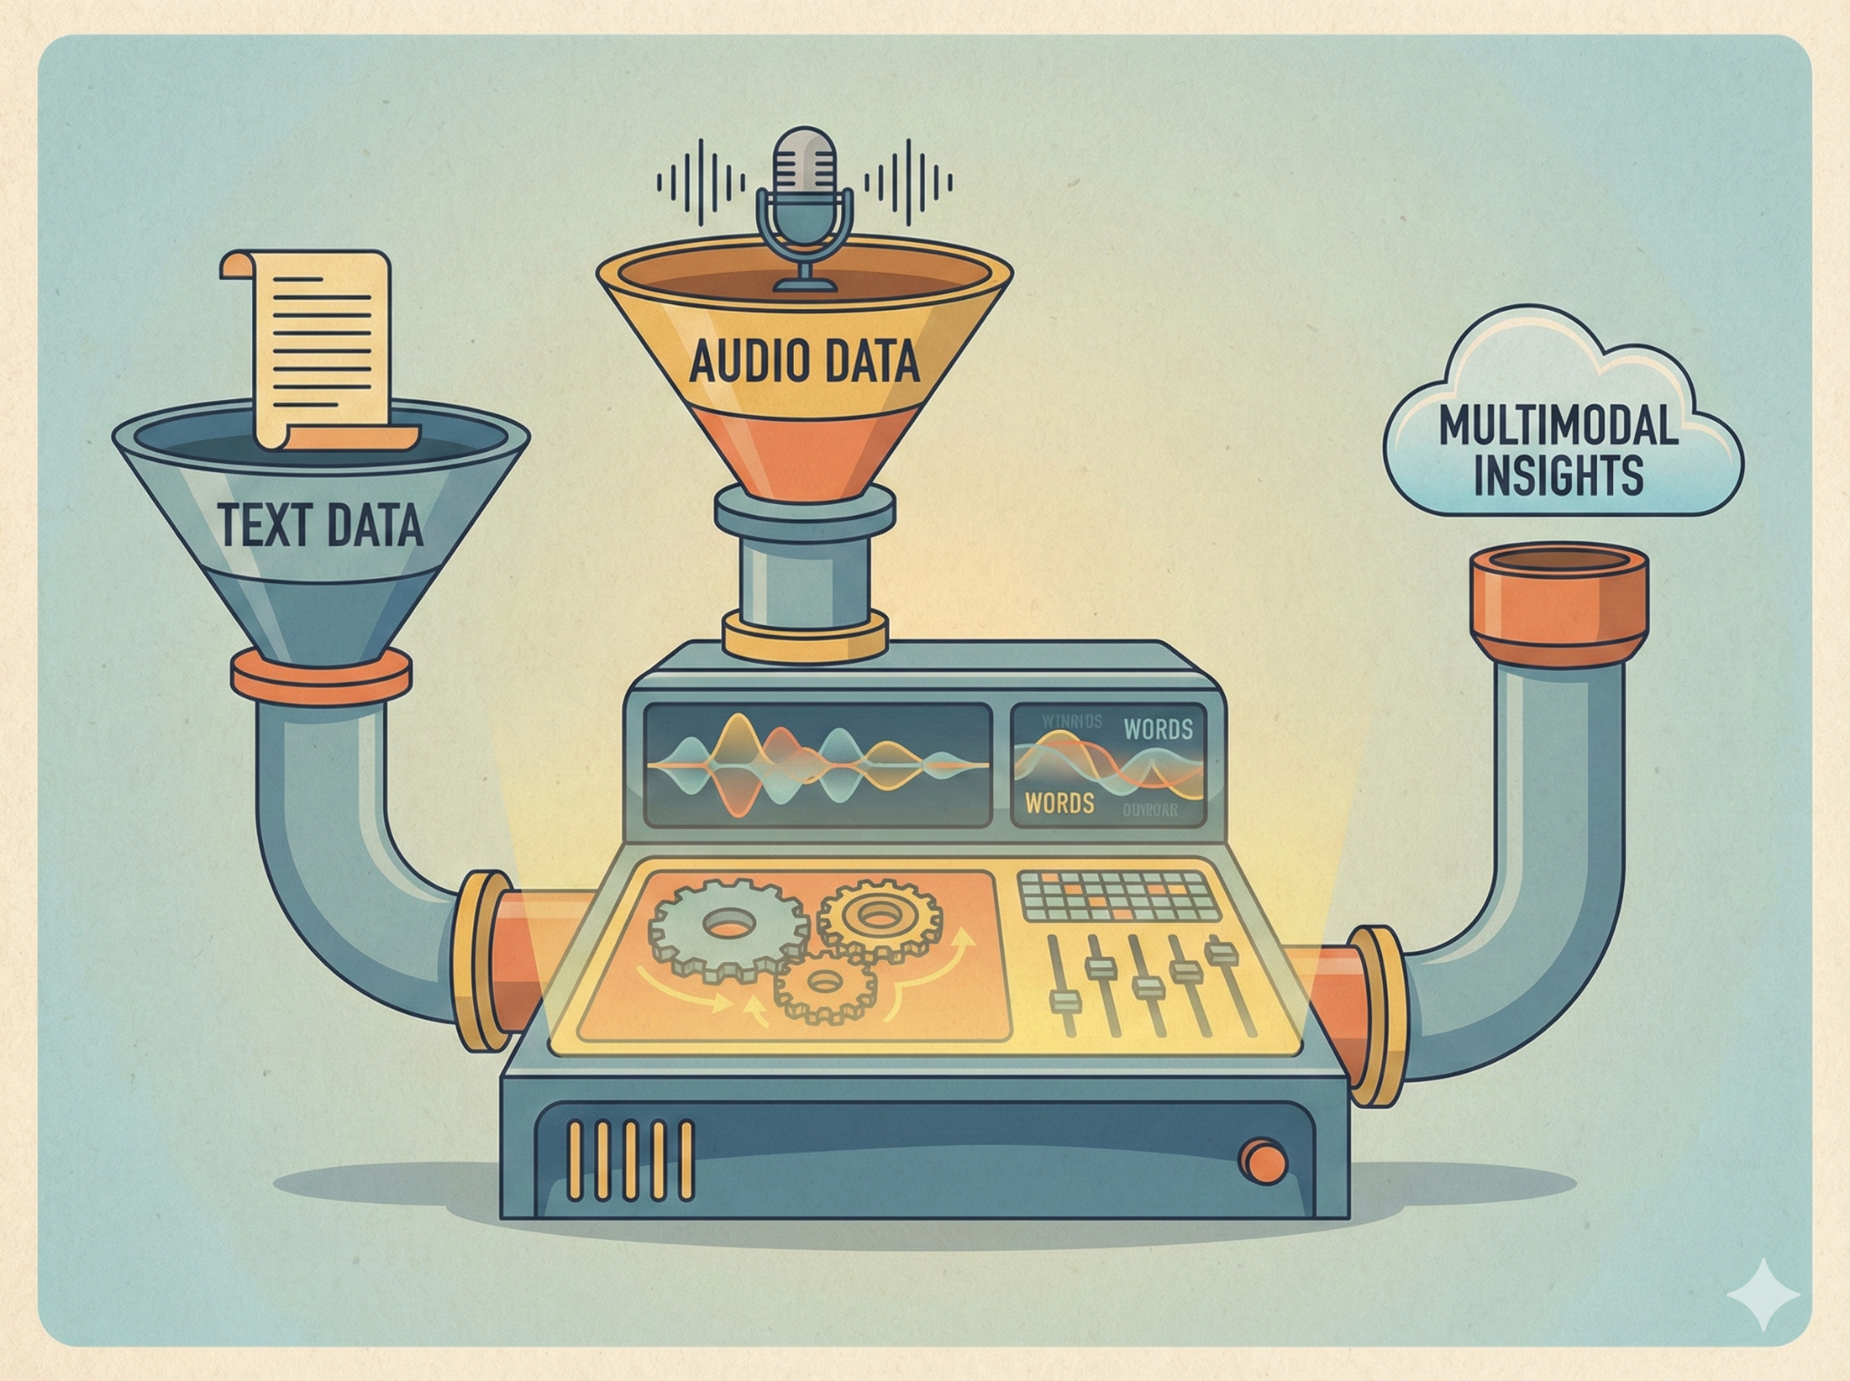
What if we try this?
Multimodal Analysis (Audio + Text)
analyze the audio of last statements alongside the text.
Analyzing the Tone
The "Trajectory" :
Death row inmate's last words with their prison correspondence, court testimonies, and initial confession over years.

Slide 34
Thanks!

Slide 35
Reference
Texas Department of Criminal Justice data source:
https://www.tdcj.texas.gov/death_row/dr_executed_offenders.html
Wikipedia: List of Last words data source:
https://en.wikipedia.org/wiki/List_of_last_words
Book: The Last word of Executed
Hugging Face Pre-trained model source:
https://huggingface.co/SamLowe/roberta-base-go_emotions

